Slide 1
FUNCTIONS
Notes:
Welcome to the module on Functions

Slide 2

In this Module You will learn
Implement functions in Python
Identify the scope of variables
Construct lambda functions
Notes:
After completing this module, you will be able to,
Implement functions in Python
Identify the scope of variables
Construct lambda functions

Slide 3
Introduction
The core of any programming language is the notion of functions
Functions allow code to be encapsulated in to individual units, which can be re-used rather than being duplicated all over the place
Define a function with a name and a sequence of statements
Functions:
Later, it is possible to call the function by name whenever it requires
Named sequence of statements that perform a computation
Functions generally takes arguments and returns a result
There could be more than one arguments and more than one value to return
The arguments and results could be of any type like number, string, Boolean, list, dictionary etc.
Notes:
Functions allow code to be encapsulated in to individual units, which can be re-used.
In the context of programming, a function is a named sequence of statements that perform a computation.
When we define a function, we specify the name and the sequence of statements.
Later, we can call the function by name, how many ever times we want, whenever we want.
Function generally takes arguments and returns a result.
This is not mandatory, though.
There could be sometimes, more than one argument and more than one value to return.
These arguments and results could be of any datatype.

Slide 4
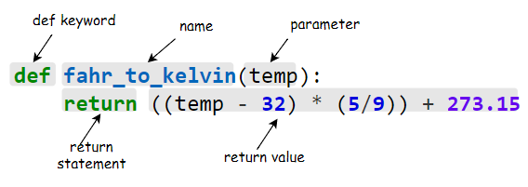
Function Definition
def: Keyword to define a function
name: Name by which the function will be called
parameter: input(s) to the function
return: Keyword used to pass variables back
return value: Variable(s) returned back accessing all the keys and values
Notes:
Let’s understand the syntax of a function.
We have to define the function using def keyword.
After the def keyword, we can provide the name of our function by which it will be called.
As discussed, function often takes one or more than one parameter as its input.
The name for these parameters should be declared within parenthesis, here.
The value to these parameters will be passed by the calling function.
After executing all the statements inside the function, the interpreter can return any value back from where it is called.
Return keyword is used to pass such variables back.
If no return statement is provided, by default a function returns None.

Slide 5
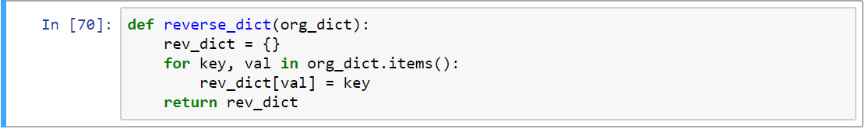
Defining Of Function
In the given example, there is a function called “reverse_dict” to reverse a dictionary
The function takes one argument which should be of type dictionary.
Inside the function, creating a empty dictionary and looping in to each element in the dictionary that is passed to the function
Inside the for loop, adding new element to the new dictionary which is created inside the function
While adding element, the key becomes the value and value becomes the key
Then it returns the new dictionary as output from the function
FEATURES:
Notes:
In the following example, we are defining a function called reverse_dict. This function takes one argument which should be of type dictionary and returns the reverse of that dictionary. That is keys of the input dictionary should be converted to values, and value of the original dictionary should be converted to keys of the new dictionary. If we pass variable with any other data type, the function might throw error in between, because we are using dictionary specific methods like .items() in the calculation. Inside the function we are creating a dictionary to which we will be pushing elements one by one. Once the empty dictionary is created, we are looping through each element in the dictionary using items method

Slide 6
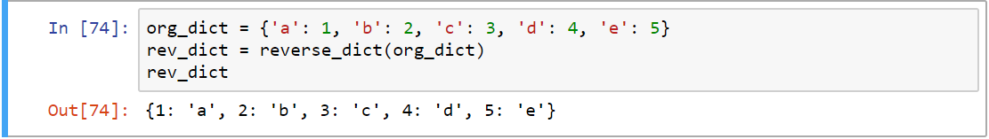
Calling Function
The function will not get executed unless we call it explicitly
In the given snippet, it creates a dictionary called org_dict.
It is possible to pass this dictionary while calling the function ‘reverse_dict()’
The output of the function is saved in the variable rev_dict
The function cannot be called without passing one parameter. It is not possible to pass more than one parameter as well
Notes:
The function will not get executed unless we call it explicitly.
Observe the code snippet where we have created a dictionary called org_dict.
We can pass this dictionary while calling the function which we just created reverse_dict().
The output of the function is saved in the variable rev_dict.
It is a must to pass one parameter to the function.

Slide 7
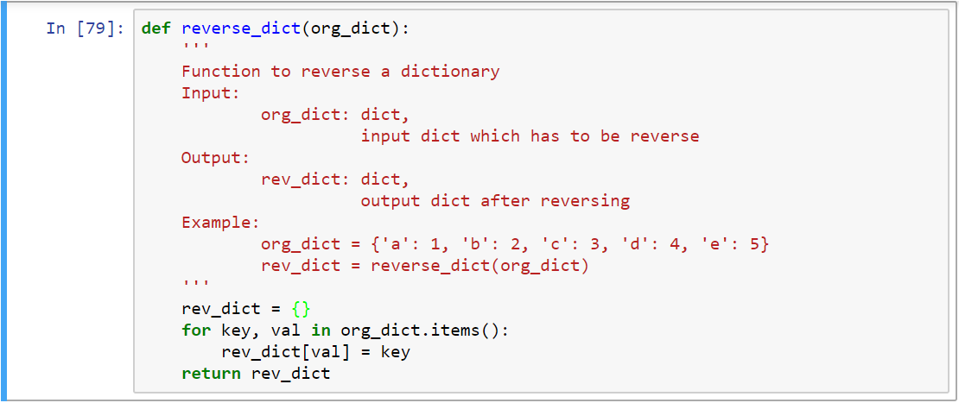
Doc Strings
Doc strings are enclosed with triple quotes
Python doc strings are used to document functions. Doc stings should follow immediately after defining function
Notes:
Python docstrings are used to document functions.
Docstrings should follow immediately after defining the function header.

Slide 8
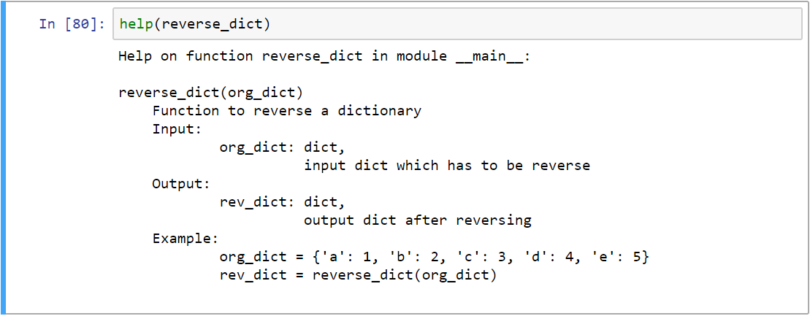
Doc Strings
Use help function to understand the documentation of any function.
It is advisable to provide documentation to any function that needs to be created
Notes:
We can use help function to understand the documentation of any function
It is advisable to provide documentation to any function that we create, so that it is obvious for others as well in terms of what operations it will do

Slide 9
Naming Parameters
Simple function which returns the second parameter as such
Parameter’s order matters while passing only values
Parameter’s order doesn’t matter if values are passed by their names
Notes:
The first snippet is a simple function definition which returns the second parameter,
The second snippet is the function call. 2 parameters are being passed.
Observe the third snippet. Parameter’s order doesn’t matter if values are passed by their names.

Slide 10
Default Arguments
Functions can take default arguments. In the given example, the parameter y is optional.
Default values will be used, if values are not passed for an argument..
If values are passed, default arguments will be over written. In the following example, though the parameter has default value as 5, when explicitly passed from the calling function, it will be overwritten. The order can also be reversed as shown, since we are passing parameters using their names.
Notes:
Functions can take default arguments. In the given example, passing the parameter y is optional
Default values will be used, if values are not passed for an argument
If values are passed, then the default arguments will be over written with the arguments passed. The order of passing parameters has no significance while the parameters are named.

Slide 11
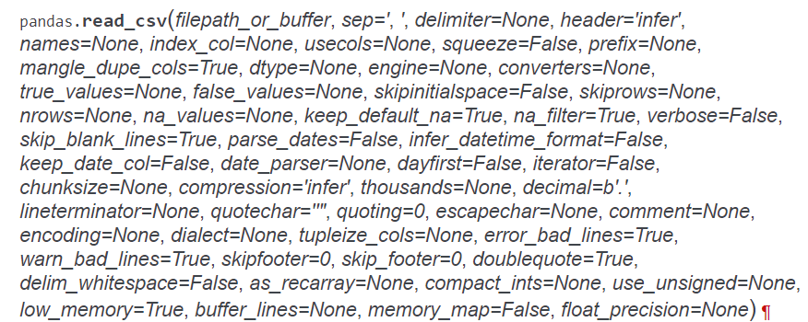
Default Arguments - Example
A function can take many input parameters and most of it can be optional
Given built-in function is such an example, which is used to read a csv file using pandas library
The function takes only one mandatory parameter, which is file path or buffer
The other bunch of parameters are optional. Most of functions from packages will be similar, because they try to address many requirements using a single function
Notes:
A function can take many input parameters.
There can be optional parameters too.
Observe the example given, read_csv method of pandas library can be used to read csvees.
The function takes only one mandatory parameter, which is filepath_or_buffer.
The other bunch of parameters are optional.

Slide 12
Scope Of Variables
Not all variables are accessible from all parts of our program, and not all variables exist for the same amount of time
Where a variable is accessible and how long it exists depend on how it is defined
The part of a program where a variable is accessible its scope and the duration for which the variable exists its lifetime
Two types of variables namely local vs. global variables.
Local variables are specific to set of statements. For example any variable inside the function is a local variable. The variable cannot be accessed outside the function
Global variable can be accessed across functions
Notes:
Not all variables are accessible from all parts of our program.
The part of a program where a variable is accessible is its scope .
And the duration for which the variable exists is its lifetime.
Two types of variables are namely local and global variables.
Local variables are those variables whose scope is only inside that function, in which it is defined.
The variable cannot be accessed outside the function.
Global variable can be accessed across functions.

Slide 13
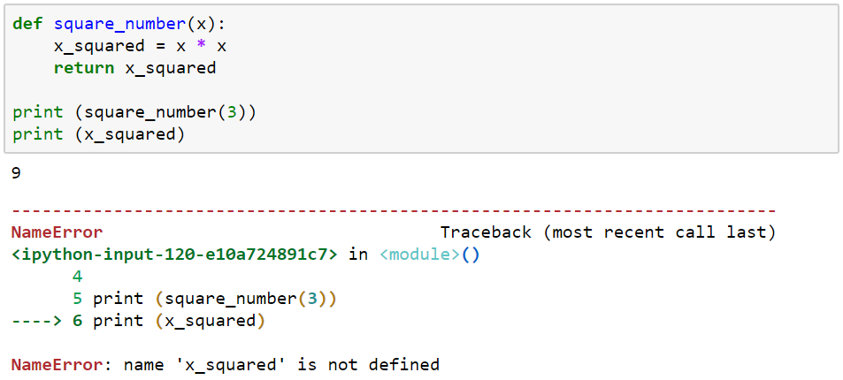
Example
In the following example we have created a function to square the value
The calculated value is stored in the variable called x_squared, and the value is returned at the end of the function
The variable x_squared is local to the function. i.e. it is available only inside that function. If tried accessing outside the function, Python will throw NameError, as shown here
The lifetime of the variable x_squared is killed the moment the function gets executed
Notes:
Here is a function to square the value.
The function takes x as the input argumen.t
The squared value is stored in the variable called x_squared, and the value is returned at the end of the function.
The variable x_squared is local to the function. Trying to access it outside the function will throw NameError.
The variable x_squared is killed the moment the function finishes its execution.

Slide 14
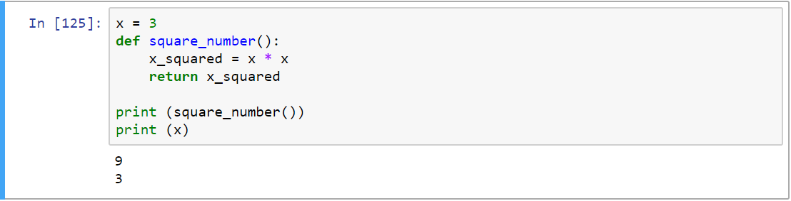
Global Variables
Observe the variable ‘x’ is created before (outside) the function.
It will be considered as global variable within the file. Any statements after the first line, will have access to the variable ‘x’
Though the variable ‘x’ is not assigned inside the function, the scope of the variable is available for calculations within the function to square the same and return the squared value.
This function doesn’t take any argument, but returns a value
Notes:
In the example given, we have created a variable x before & outside the function.
Now, this is a global variable. Any statement after the first line, will have access to the variable x.
Though we have not assigned the variable x inside the function, this variable is available for the calculation.
The function returns the squared value. See, the function doesn’t take any argument, but returns a value.

Slide 15
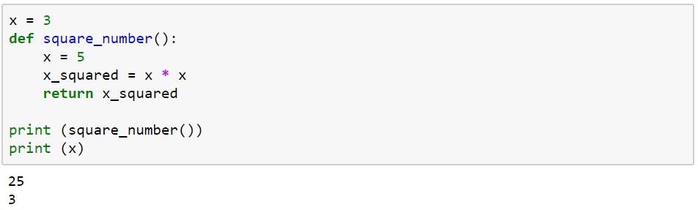
Global & Local Variable
The following example can be used to get a clear picture of global vs. local variables
Here in the example, variable x is defined in two places. One value outside the function (global variable) has value 3 and the one which is defined inside the function (local variable) with a value 5
While calculating the square inside the function, the value of x will be 5 and so it returns 25.
But while printing x again outside the function, the value will be 3 only. Because the value of 5 is local to the function, outside the function the value will be 3 only
Notes:
See this example, we have defined the variable x in two places.
One, outside the function (x is given the value 3) and another inside the function (x is given the value 5).
On calculating the square inside the function, 5 gets squared and 25 is returned.
On printing x again outside the function, the value 3 gets printed.
Because the value 5 for x is local to the function, while the value 3 is global.

Slide 16
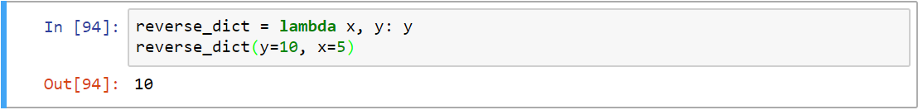
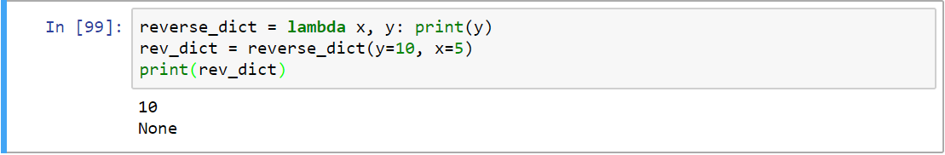
LAMBDA FUNCTIONS
Single line functions are called as lambda functions
Lambda functions at times can be anonymous i.e. without a name
Followed by the keyword lambda, is a list of arguments, separated by commas
The entire body of the function is just a single expression used to return a value. Hence an explicit return keyword is not required
Notes:
Single line functions are called as lambda functions
Lambda functions at times can be anonymous i.e. without a function name
We must specify the lambda function using the keyword lambda, followed by the list of arguments that the function has to deal with, separated by commas.
The entire body of the function is just a single expression and this returns a value by default. Hence an explicit return keyword is not required.

Slide 17
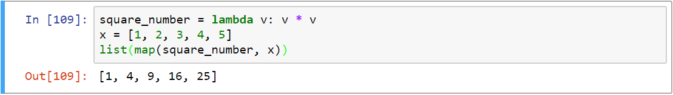
Map & Filter
Map applies a function to all the items in an input list. It takes two arguments.
First the function which needs to be applies to each element in the list, second the list itself.
Filter is another useful method to filter only those values which matches the condition inside the filter.
For example the below code, only those values which are less than 3 will be returned.
Notes:
Map applies a function to all the items in an input list. It takes two arguments.
First the function which needs to be applied to each element in the list, second the list itself.
Filter is another useful method to filter only those values which matches the condition inside the filter.

Slide 18
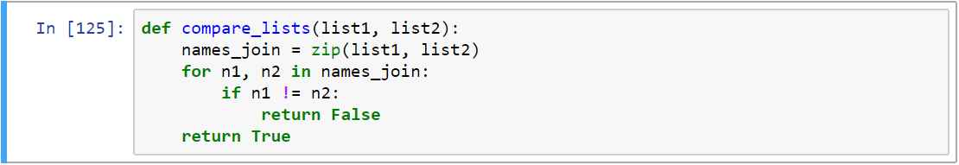
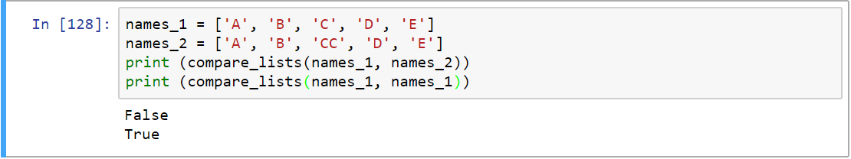
Sample Program
Problem: Compare two list
Solution:
Notes:
Observe the program that depicts how to compare 2 lists.

Slide 19

In this Module You have learnt to
Implement functions in Python
Identify the scope of variables
Construct lambda functions
Notes:
Having completed this session you would have learnt to ,
Implement functions in Python
Identify the scope of variables
Construct lambda functions

Slide 20

THANK you
Notes:
THANK you FOR the attention.

